Slide 1

non mvc Model
Data
access
request
Model
(bean)
response
jsp

Slide 2
mvc Model
Data
access
DAO
request
Model
(bean)
response
jsp

Slide 3
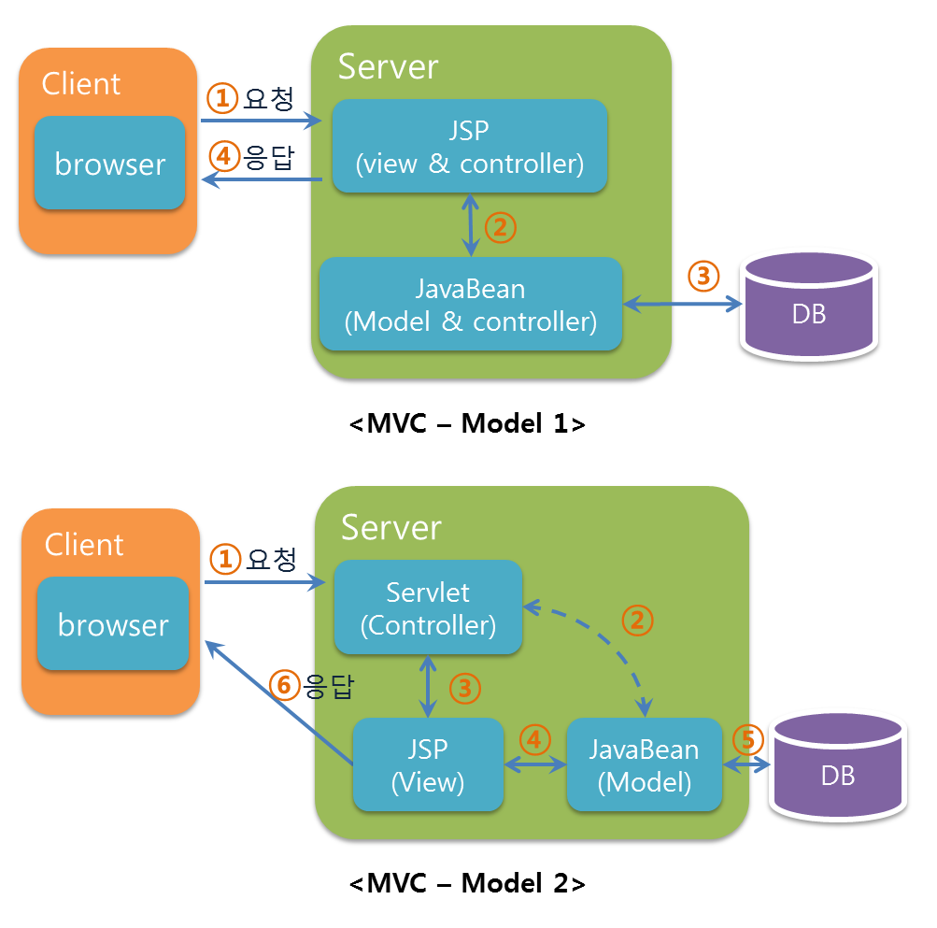
mvc Model

